Slide 1

Visualizing – Stocks
- Aditya Sabbineni

Slide 2


Root Cause of Problem - Laziness

Slide 3
Problem Statement Follows

Slide 4
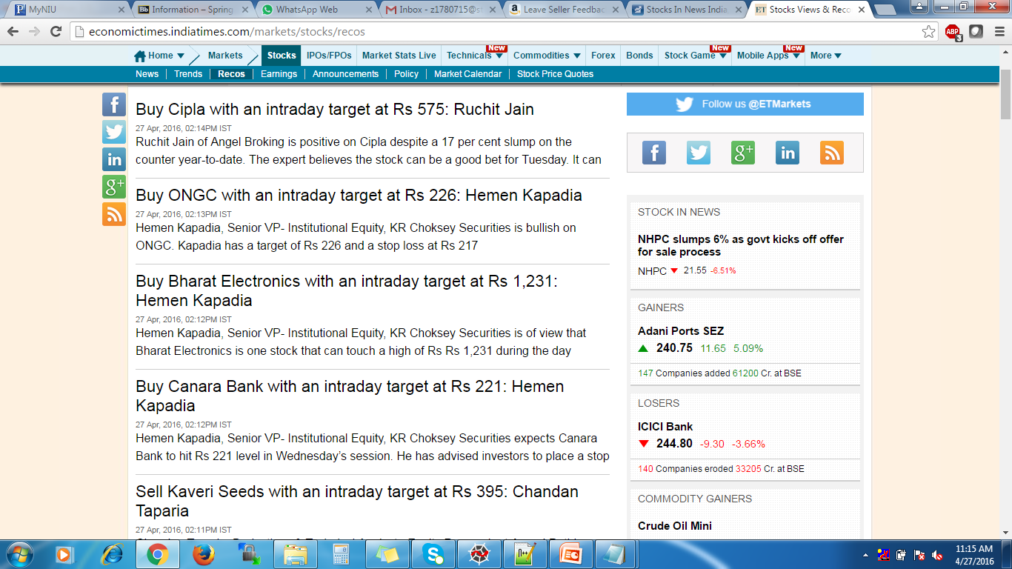
Recommendations

Slide 5
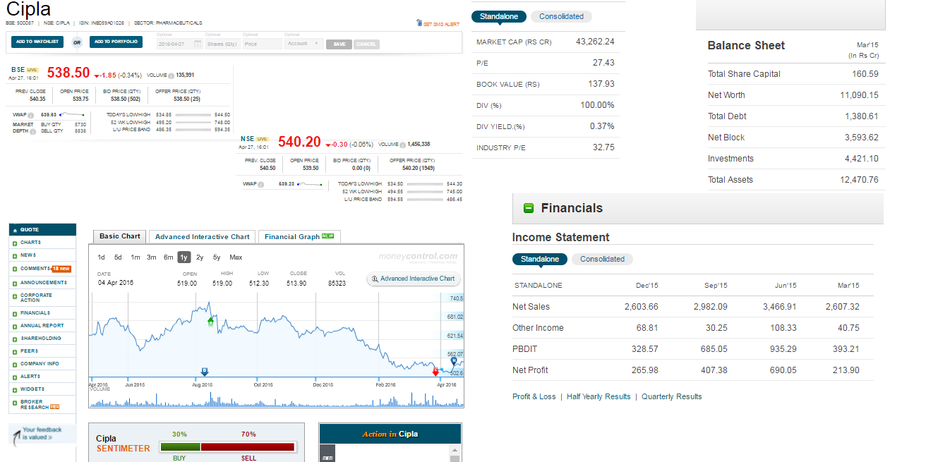

Slide 6


Think + Analyse
+

Slide 7


Slide 8

My Solution Follows :

Slide 9
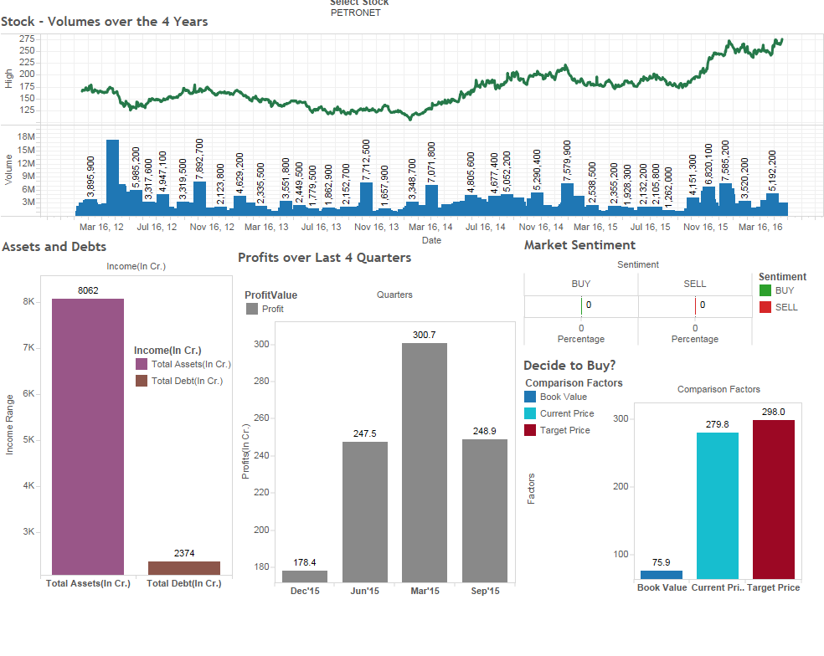

Slide 10
Implementation - Algorithm
Get Recommendation Stocks from Website
Get Stock Codes from the Stock Names
getStockCodes()
getStockSymbols() – Helper function
Main()
Visualize Data
Organize Data into CSV
Get Stock Analysis Da from Money Control Website
formatData – Clean the data
getStockData – Write data into csv files
funcMC – driver for MC
getMCUrls – Get stock Urls
getMCData – Get all data values from the Urls

Slide 11
TakeAway
Python Regular expressions, lot of syntax, basic python data structures, crawling with urllib
Experience with lot of data
Great experience working closely with web-requests and headers
Lots of fun+confidence

Slide 12
Thank You

